Slide 1
Artificial Intelligence
Introduction

Slide 2
Why Study AI?
A student in physics might reasonably feel that all the good ideas have already been taken by Galileo, Newton, Einstein, and the rest. AI, on the other hand, still has openings for several full-time Einsteins and Edisons.

Slide 3
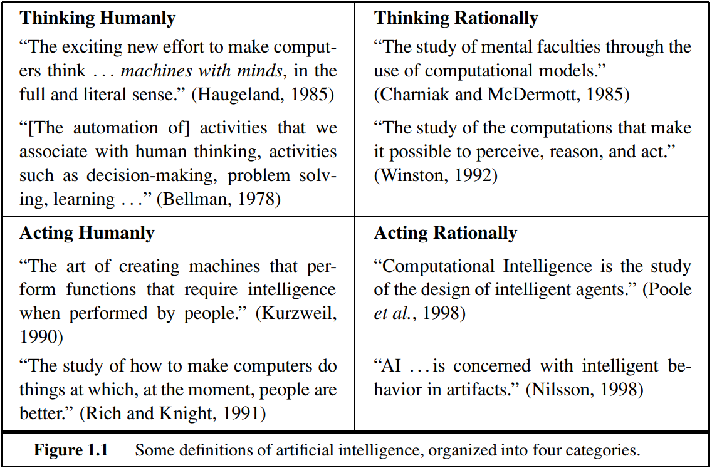
What is AI?
success measure in terms of fidelity to human performance
success measure against an ideal performance measure, called rationality
Views of AI falls into four categories
A system is rational if it does the “right thing”, given what it knows.
thought processes and reasoning
Thinking Humanly | Thinking Rationally
Acting Humanly | Acting Rationally
behavior

Slide 4
Rational Decisions
We’ll use the term rational in a very specific, technical way:
Rational: maximally achieving pre-defined goals
Rationality only concerns what decisions are made
(not the thought process behind them)
Goals are expressed in terms of the utility of outcomes
Being rational means maximizing your expected utility
A better title for this course would be:
Computational Rationality
Notes:
Example of utilities. 10 for A, 1 for each Friday with friends

Slide 5
Identify the AI Type
Siri telling a joke →
AI solving a math theorem logically →
AI modeling human memory errors →
Self-driving car deciding when to stop →
ChatGPT writing in a friendly tone →
Netflix recommending a movie →
Customer-service bot apologizing politely →
Google Maps avoiding traffic →

Slide 6
Identify the AI Type
Siri telling a joke → Acting Humanly
AI solving a math theorem logically → Thinking Rationally
AI modeling human memory errors → Thinking Humanly
Self-driving car deciding when to stop → Acting Rationally
ChatGPT writing in a friendly tone → Acting Humanly
Netflix recommending a movie → Acting Rationally
Customer-service bot apologizing politely → Acting Humanly
Google Maps avoiding traffic → Acting Rationally

Slide 7
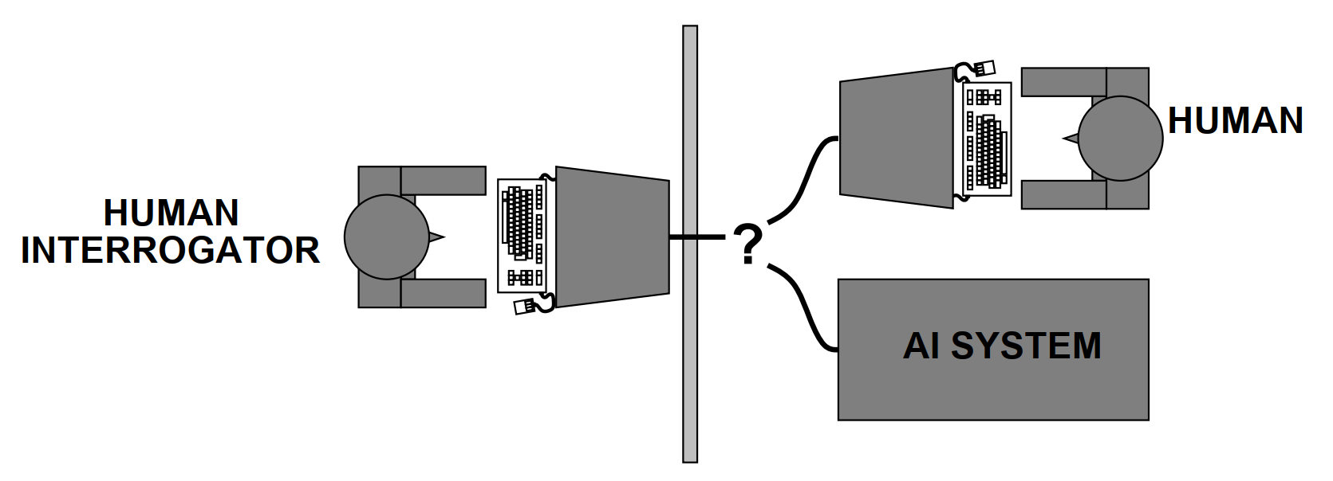
Acting humanly The Turing Test approach
A computer passes the test if a human interrogator, after posing some written questions, cannot tell whether the written responses come from a person or from a computer.
Proposed by Alan Turing (1950)
Total Turing Test includes a video signal so that the interrogator can test the subject’s perceptual abilities, as well as the opportunity for the interrogator to pass physical objects “through the hatch.”
The computer would need to possess the following capabilities
Natural Language Processing
Knowledge Representation
Automated Reasoning
Machine Learning
To pass the total Turing Test, the computer will also need
Computer Vision
Robotics
Notes:
CAPTCHA, an acronym for Completely Automated Public Turing test to tell Computers and Humans Apart

Slide 8
Acting humanly The Turing Test approach
Problem
Turing test is not reproducible, constructive or amendable to mathematical analysis
AI researchers have devoted little effort to passing the Turing Test, believing that it is more important to study the underlying principles of intelligence than to duplicate an exemplar.
Notes:
CAPTCHA, an acronym for Completely Automated Public Turing test to tell Computers and Humans Apart
Yet AI researchers have devoted little effort to passing the Turing Test, believing that it is more important to study the underlying principles of intelligence than to duplicate an exemplar. The quest for “artificial flight” succeeded when the Wright brothers and others stopped imitating birds and started using wind tunnels and learning about aerodynamics. Aeronautical engineering texts do not define the goal of their field as making “machines that fly so exactly like pigeons that they can fool even other pigeons.”

Slide 9
This course concentrates on
General principles of rational agents
Components for constructing them

Slide 10
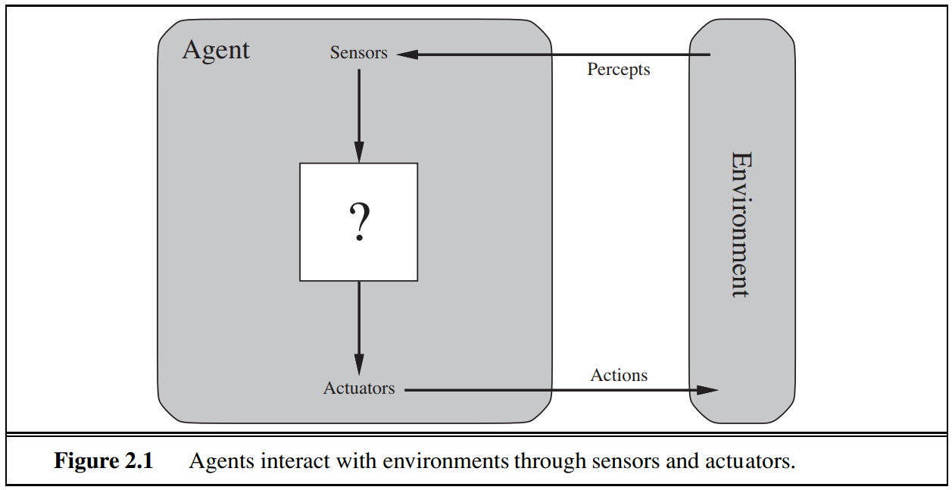
Agents and Environments
An agent is anything that can be viewed as perceiving its environment through sensors and acting upon that environment through actuators

Slide 11
Agents and Environments
An agent is anything that can be viewed as perceiving its environment through sensors and acting upon that environment through actuators
 | A human agent | A robotic agent | A software agent
Sensors | eyes, ears | cameras and infrared range finders | keystrokes, file contents, and network packets
Actuators | hands, legs, vocal tract | various motors | displaying on the screen, writing files, and sending network packets

Slide 12
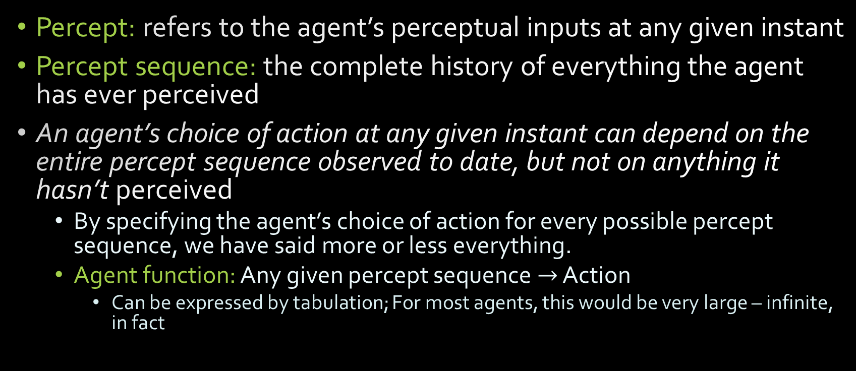
Agents and Environments
Notes:
By specifying the agent’s choice of action for every possible percept sequence, we have said more or less everything.

Slide 13
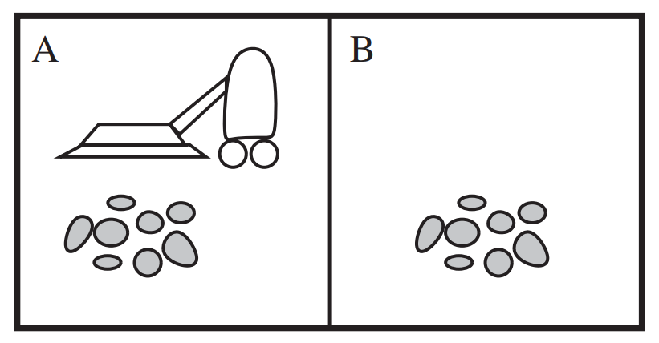
Agents and Environments The vacuum-cleaner world
Two locations only
Perception
Which square it is in
Whether there is dirt in the square
Possible actions
Move left
Move right
Suck up the dirt
Do nothing
Agent function
if the current square is dirty, then suck
else move to the other square.

Slide 14
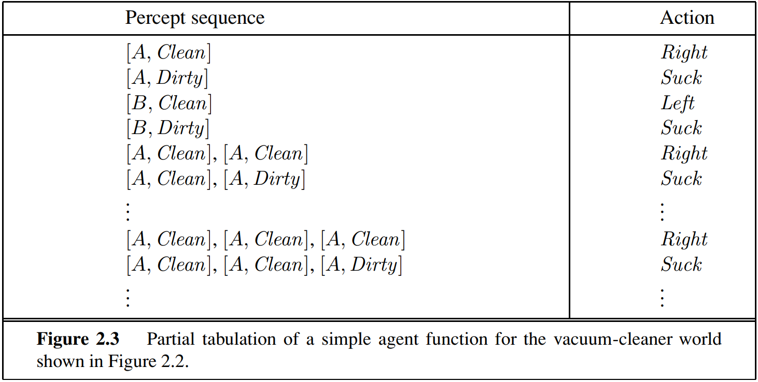
Agents and Environments The vacuum-cleaner world
What is the right way to fill out the table?
What makes an agent good or bad, intelligent or stupid?

Slide 15
Agents and Environments
In a sense, all areas of engineering can be seen as designing artifacts that interact with the world; AI operates the most interesting end of the spectrum, where the artifacts have significant computational resources and the task environment requires nontrivial decision making

Slide 16
Good Behavior: The Concept of Rationality
A rational agent is one that does the right thing.
But, what does it mean to do the right thing?
Measure performance of the vacuum cleaner agent by
the amount of dirt cleaned up in a single eight-hour shift?
Or,
One point could be awarded for each clean square at each time step (perhaps with a penalty for electricity consumed and noise generated)?

Slide 17
Good Behavior: The Concept of Rationality
A rational agent is one that does the right thing.
But, what does it mean to do the right thing?
One point could be awarded for each clean square at each time step (perhaps with a penalty for electricity consumed and noise generated)?
The same average cleanliness can be achieved by two different agents, one of which does a mediocre job all the time while the other cleans energetically but takes long breaks. Which is preferable?

Slide 18
Good Behavior: The Concept of Rationality
What is rational at any given time depends on four things
The performance measure that defines the criterion of success.
The agent’s prior knowledge of the environment.
The actions that the agent can perform.
The agent’s percept sequence to date.
Definition of a rational agent:
For each possible percept sequence, a rational agent should select an action that is expected to maximize its performance measure, given the evidence provided by the percept sequence and whatever built-in knowledge the agent has.

Slide 19
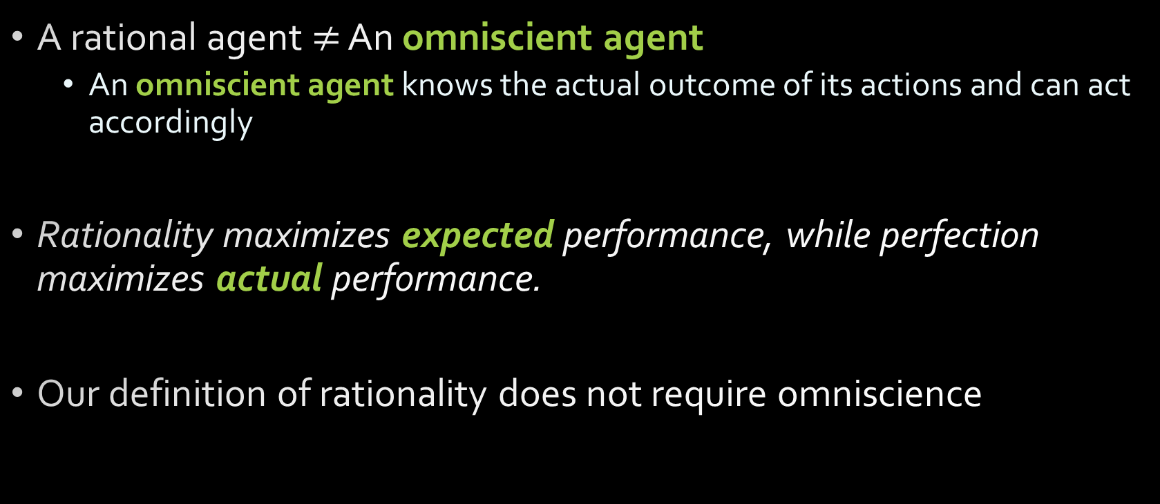
Rationality vs. Omniscience

Slide 20
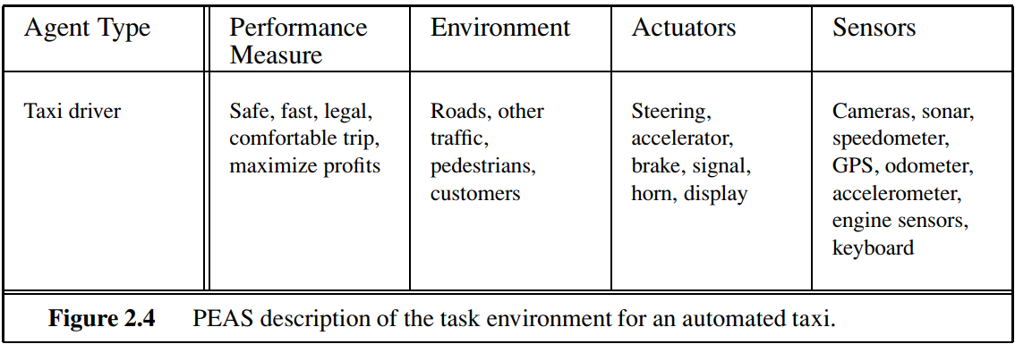
Specifying the task environment
In designing an agent, the first step must always be to specify the task environment as fully as possible
PEAS (Performance, Environment, Actuators, Sensors)

Slide 21
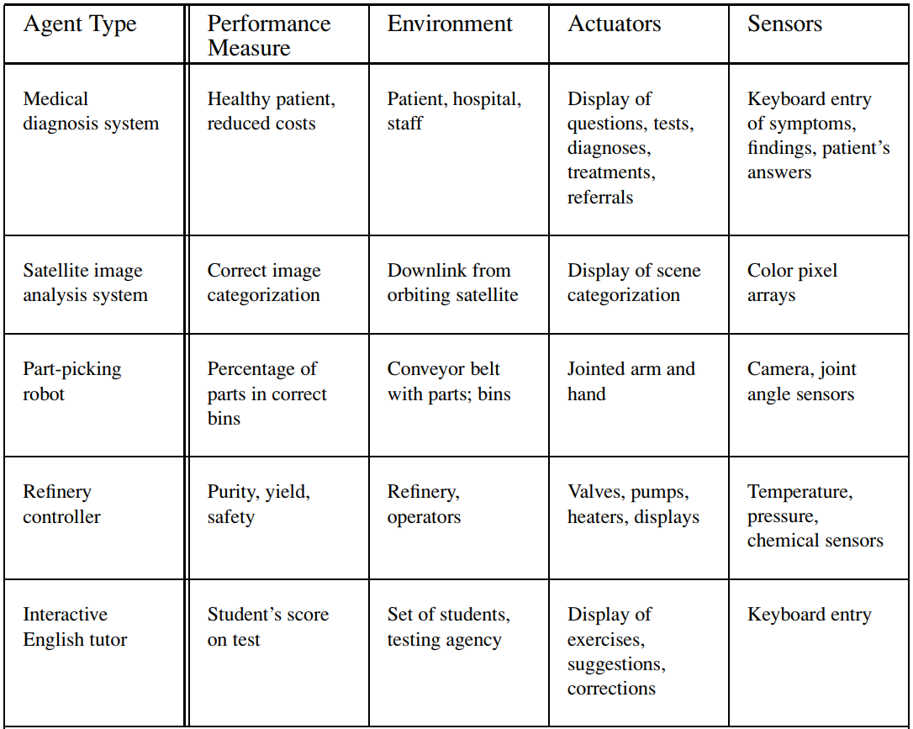
Notes:
Some “real” environments are actually quite simple. For example, a robot designed to inspect parts as they come by on a conveyor belt can make use of a number of simplifying assumptions: that the lighting is always just so, that the only thing on the conveyor belt will be parts of a kind that it knows about, and that only two actions (accept or reject) are possible.
Imagine a softbot Web site operator designed to scan Internet news sources and show the interesting items to its users, while selling advertising space to generate revenue. To do well, that operator will need some natural language processing abilities, it will need to learn what each user and advertiser is interested in, and it will need to change its plans dynamically—for example, when the connection for one news source goes down or when a new one comes online

Slide 22
PEAS QUIZ!
What is the PEAS specification for a Robot Soccer Player? What are the environmental characteristics of this agent?
What is the PEAS specification for an Online Shopping Agent? What are the environmental characteristics of this agent?
Notes:
Internet shopping agent:
PEAS description
Performance measure: price, quality, appropriateness, efficiency
Environment: current and future WWW sites, vendors, shippers
Actuators: display to user, follow URL, fill in form
Sensors: HTML pages (text, graphics, scripts)
Environment Characteristics:
Fully observable: No
Deterministic: Partly // partially observable
Episodic: No // sequential
Static: Semi // the world changes partly while the agent is thinking
Discrete: Yes
Single-agent: No // multi-agent
PEAS for Robot Soccer Player:
Performance Measure (P): To Play, Make Goal & Win the Game.
Environment (E): Soccer, Team Members, Opponents, Referee, Audience and Soccer Field.
Actuators (A): Navigator, Legs of Robot, View Detector for Robot.
Sensors (S): Camera, Communicators and Orientation & Touch Sensors.
Environment:
Partially Observable, Stochastic, Sequential, Dynamic, Continuous and Multi Agent.

Slide 23
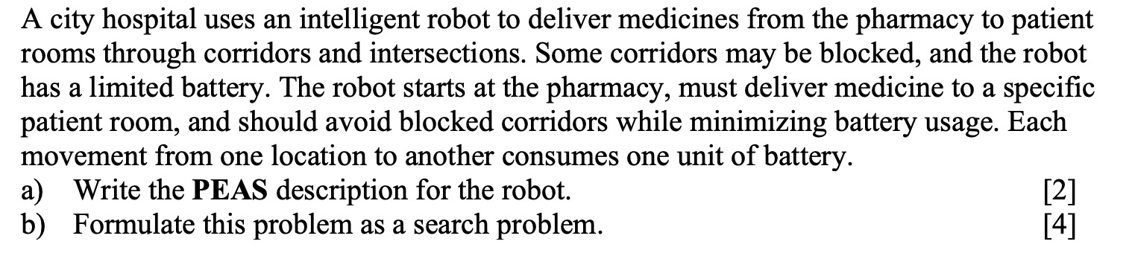
PEAS & Problem Formulation

Slide 24
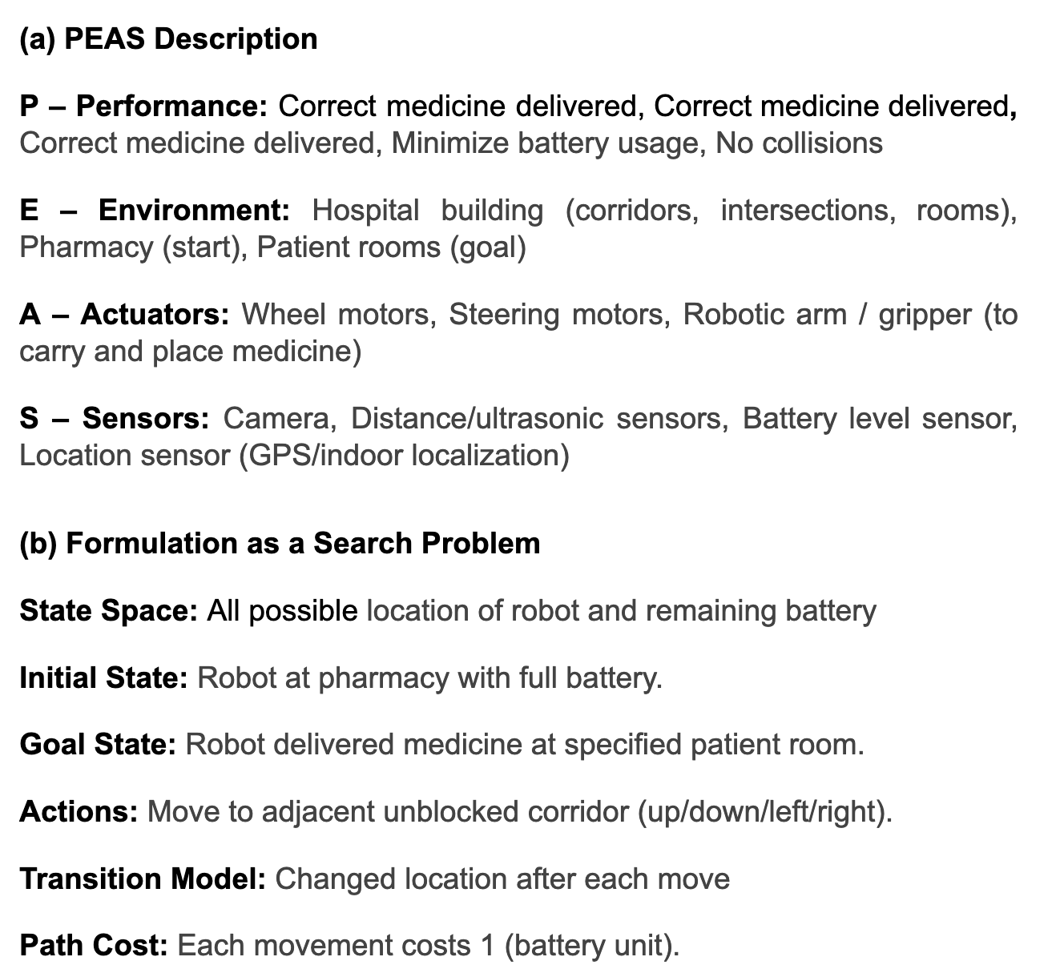
Solution

Slide 25
Properties of task environments
Fully observable vs. Partially observable
Single agent vs. Multi-agents
Deterministic vs. Stochastic
Episodic vs. Sequential
Static vs. Dynamic
Discrete vs. Continuous
Known vs. Unknown

Slide 26
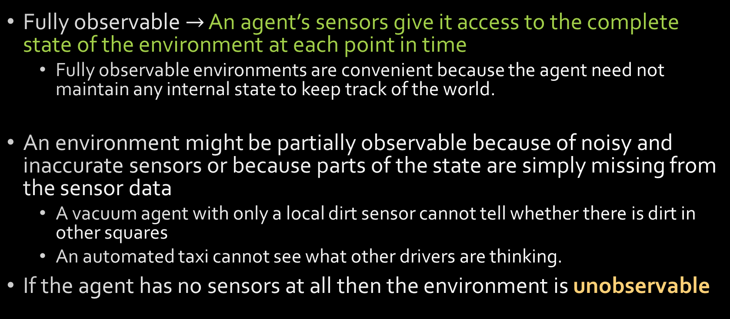
Types of Environment Fully observable vs. partially observable

Slide 27
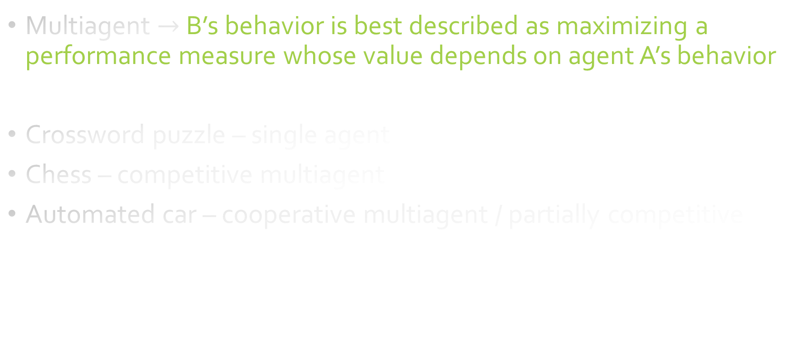
Types of Environment Single agent vs. multiagent
Explain why automated car can be partially competitive multi-agent?

Slide 28
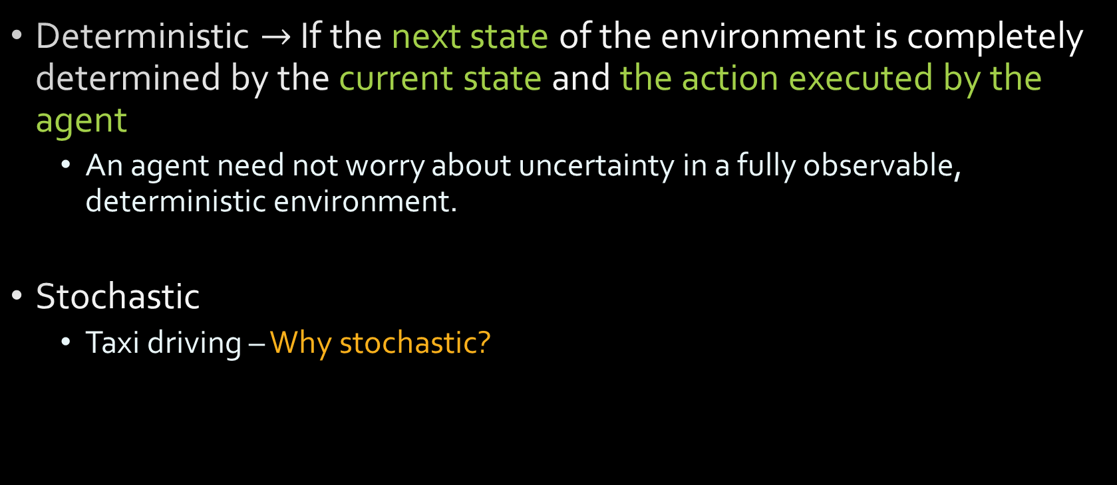
Types of Environment Deterministic vs. stochastic
If dirt appears randomly In our vacuum world, is it deterministic? No – Why?
Notes:
because one can never predict the behavior of traffic exactly; moreover, one’s tires blow out and one’s engine seizes up without warning.
The vacuum world as we described it is deterministic, but variations can include stochastic elements such as randomly appearing dirt and an unreliable suction mechanism

Slide 29
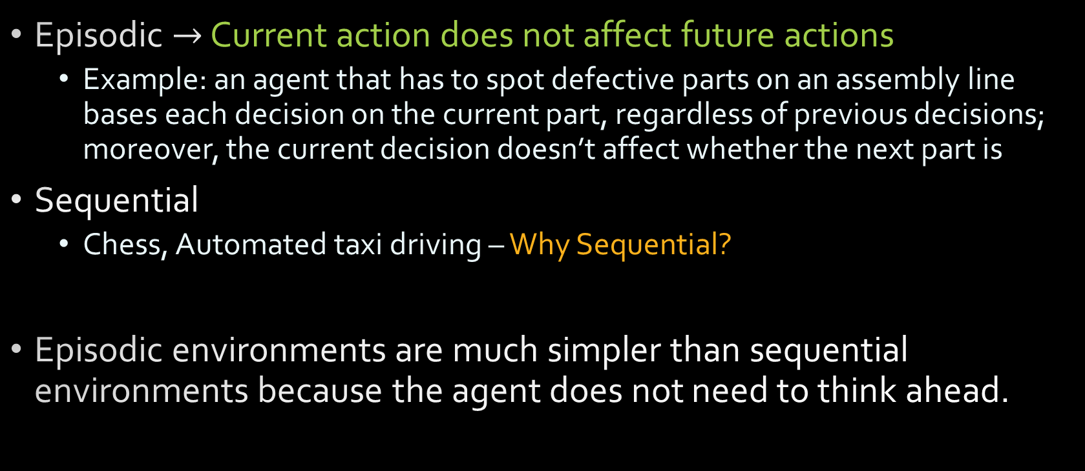
Types of Environment Episodic vs. sequential

Slide 30
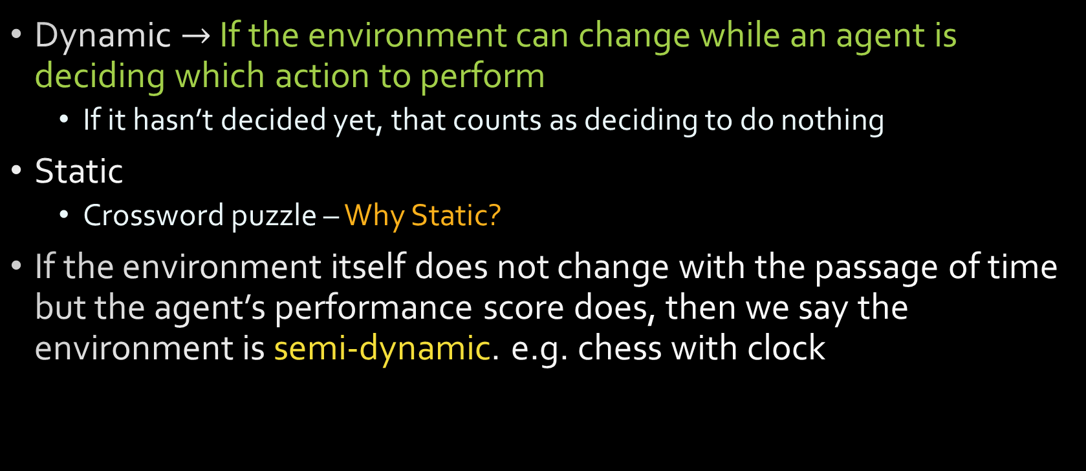
Types of Environment Static vs. dynamic
Explain why chess with clock is semi dynamic?

Slide 31
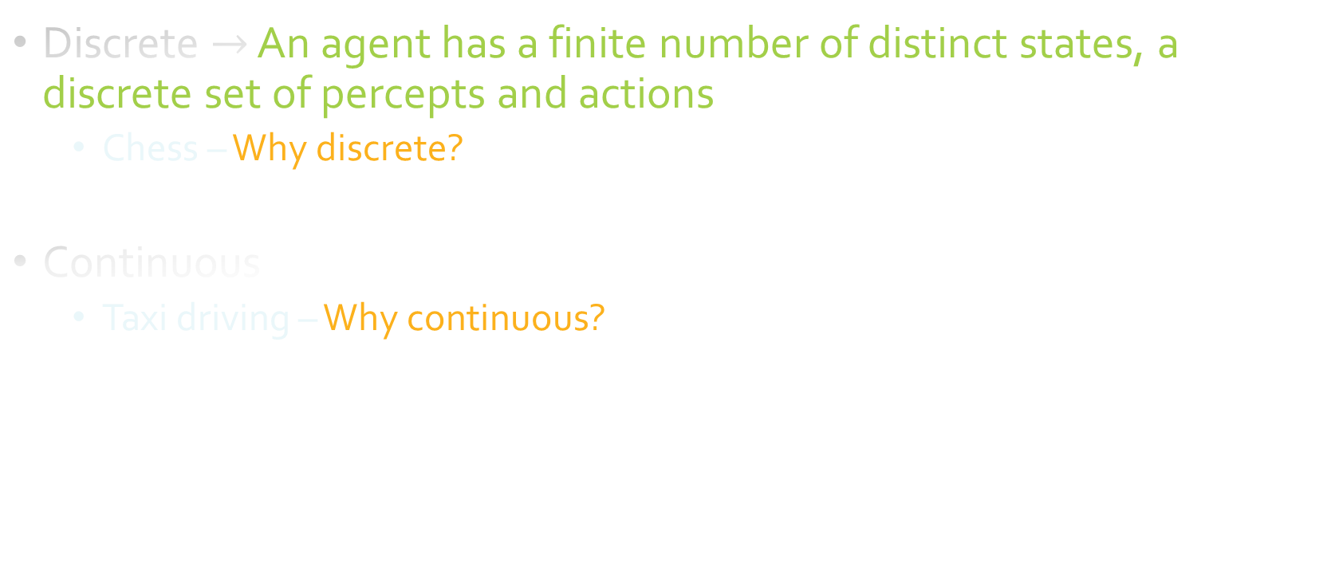
Types of Environment Discrete vs. continuous

Slide 32
Types of Environment
The hardest case is partially observable, multiagent, stochastic, sequential, dynamic, continuous, and unknown
Taxi driving is hard in all these senses, except that for the most part the driver’s environment is known

Slide 33
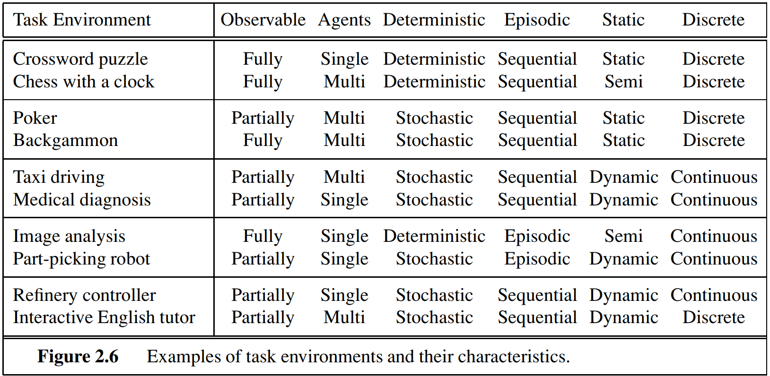
Types of Environment
Answers in this table depend on how the task environment is defined

Slide 34
Types of Environment

Slide 35
Answers in this table depend on how the task environment is defined
Medical-diagnosis task
single-agent because the disease process in a patient is not profitably modeled as an agent; but a medical-diagnosis system might also have to deal with recalcitrant patients and skeptical staff, so the environment could have a multiagent aspect
episodic if one conceives of the task as selecting a diagnosis given a list of symptoms; the problem is sequential if the task can include proposing a series of tests, evaluating progress over the course of treatment, and so on.
A chess tournament consists of a sequence of games; each game is an episode because (by and large) the contribution of the moves in one game to the agent’s overall performance is not affected by the moves in its previous game. On the other hand, decision making within a single game is certainly sequential.

Slide 36
References
AIMA Chapter 1 and 2
1.1, 1.4
2.1, 2.2, 2.3
AIMA slides: Lecture-1,2 http://aima.eecs.berkeley.edu/slides-pdf/
Previous year questions

Slide 37
Some Excellent Resources!
2019 Berkeley CS 188 - Introduction to Artificial Intelligence
UC Berkeley CS 188 Introduction to Artificial Intelligence, Fall 2018
MIT 6.034 Artificial Intelligence, Fall 2010
Mohammad Imam Hossain https://www.slideshare.net/imamhossain75054/presentations/2

Slide 38
Thinking humanly The cognitive modeling approach
We need to get inside the actual workings of human minds through
Introspection
Psychological experiments
Now cognitive science
Brain imaging
Now cognitive neuroscience
Once we have a sufficiently precise theory of the mind, it becomes possible to express the theory as a computer program.
The interdisciplinary field of cognitive science brings together computer models from AI and experimental techniques from psychology to construct precise and testable theories of the human mind.
Computer vision, which incorporates neurophysiological evidence into computational models

Slide 39
Thinking rationally The “laws of thought” approach
Aristotle was one of the first to attempt to codify “right thinking,” that is, irrefutable reasoning processes.
Always yielded correct conclusions when given correct premises—for example, “Socrates is a man; all men are mortal; therefore, Socrates is mortal.”
These laws of thought were supposed to govern the operation of the mind; their study initiated the field called logic
Obstacles
It is not easy to take informal knowledge and state it in the formal terms required by logical notation, particularly when the knowledge is less than 100% certain
There is a big difference between solving a problem “in principle” and solving it in practice. Even problems with just a few hundred facts can exhaust the computational resources of any computer unless it has some guidance as to which reasoning steps to try first.
Notes:
when the knowledge is less than 100% certain – for example, we can guess from a customer’s buying pattern that he likes coffee without being 100% certain

Slide 40
Acting rationally The rational agent approach
An agent is just something that acts
A computer agent is expected to
operate autonomously
perceive their environment
persist over a prolonged time period
adapt to change, and
create and pursue goals.
A rational agent is one that acts so as to achieve the best outcome or, when there is uncertainty, the best expected outcome.
In the “laws of thought” approach to AI, the emphasis was on correct inferences. Making correct inferences is sometimes part of being a rational agent, but, correct inference is not all of rationality; in some situations, there is no provably correct thing to do, but something must still be done. There are also ways of acting rationally that cannot be said to involve inference.
All the skills needed for the Turing Test also allow an agent to act rationally.
Notes:
in some situations, there is no provably correct thing to do, but something must still be done- example?

Slide 41
Acting rationally The rational agent approach
Advantages over the other approaches
It is more general than the “laws of thought” approach because correct inference is just one of several possible mechanisms for achieving rationality
It is more amenable to scientific development than are approaches based on human behavior or human thought. The standard of rationality is mathematically well defined and completely general, and can be “unpacked” to generate agent designs that provably achieve it.
One important point to keep in mind: We will see before too long that achieving perfect rationality—always doing the right thing—is not feasible in complicated environments. The computational demands are just too high.

